Slide 1
Designing of a Pitot-Static Tube
Team Members
Nipun Gunarathne – Device design Engineer
Wu Fan – Installation system design Engineering
Gaurawa Kovida – Test Engineer

Slide 2

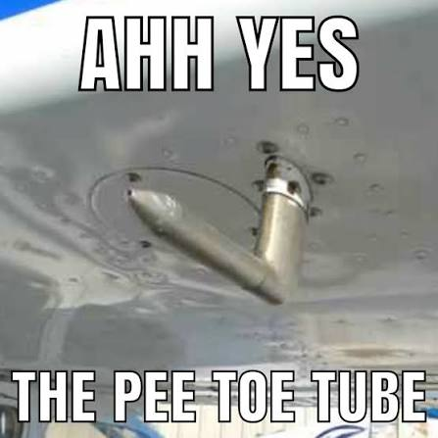
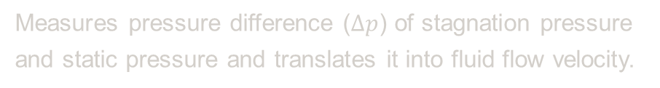
Introduction
What is it really?
It is widely used to determine the airspeed of aircraft; the water speed of boats; and the flow velocity of liquids, air, and gases in industry
Measures pressure difference ($∆p$) of stagnation pressure and static pressure and translates it into fluid flow velocity.
Since Bernoulli’s principles are considered here, fluid flow is treated as;
Non-viscous
Streamlined
Incompressible
No energy addition or loss
01

Slide 3

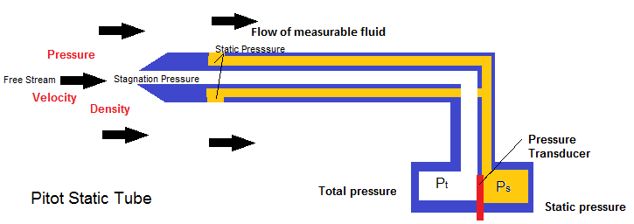

Aerodynamic Theory: Bernoulli's Principle
The core physics of our setup relies on isolating dynamic pressure to calculate true airspeed.
A Pitot-static tube and the manometer connected simultaneously measures the stagnation pressure and the local static pressure.
v$=\sqrt{\frac{2(p_{o}−p)}{ρ}}$
•
$v$: True Airspeed (m/s)
•
$p$: Stagnation Pressure (Inner tube)
https://forums.ni.com/t5/Example-Code/Pitot-Static-Tube-Pressure-Calculations-with-DAQmx-Acquisition/ta-p/3530828
•
$p_{0}$: Static Pressure (Outer PVC chamber)
•
$ρ$: Air Density (~1.225 kg/m³)
02

Slide 4
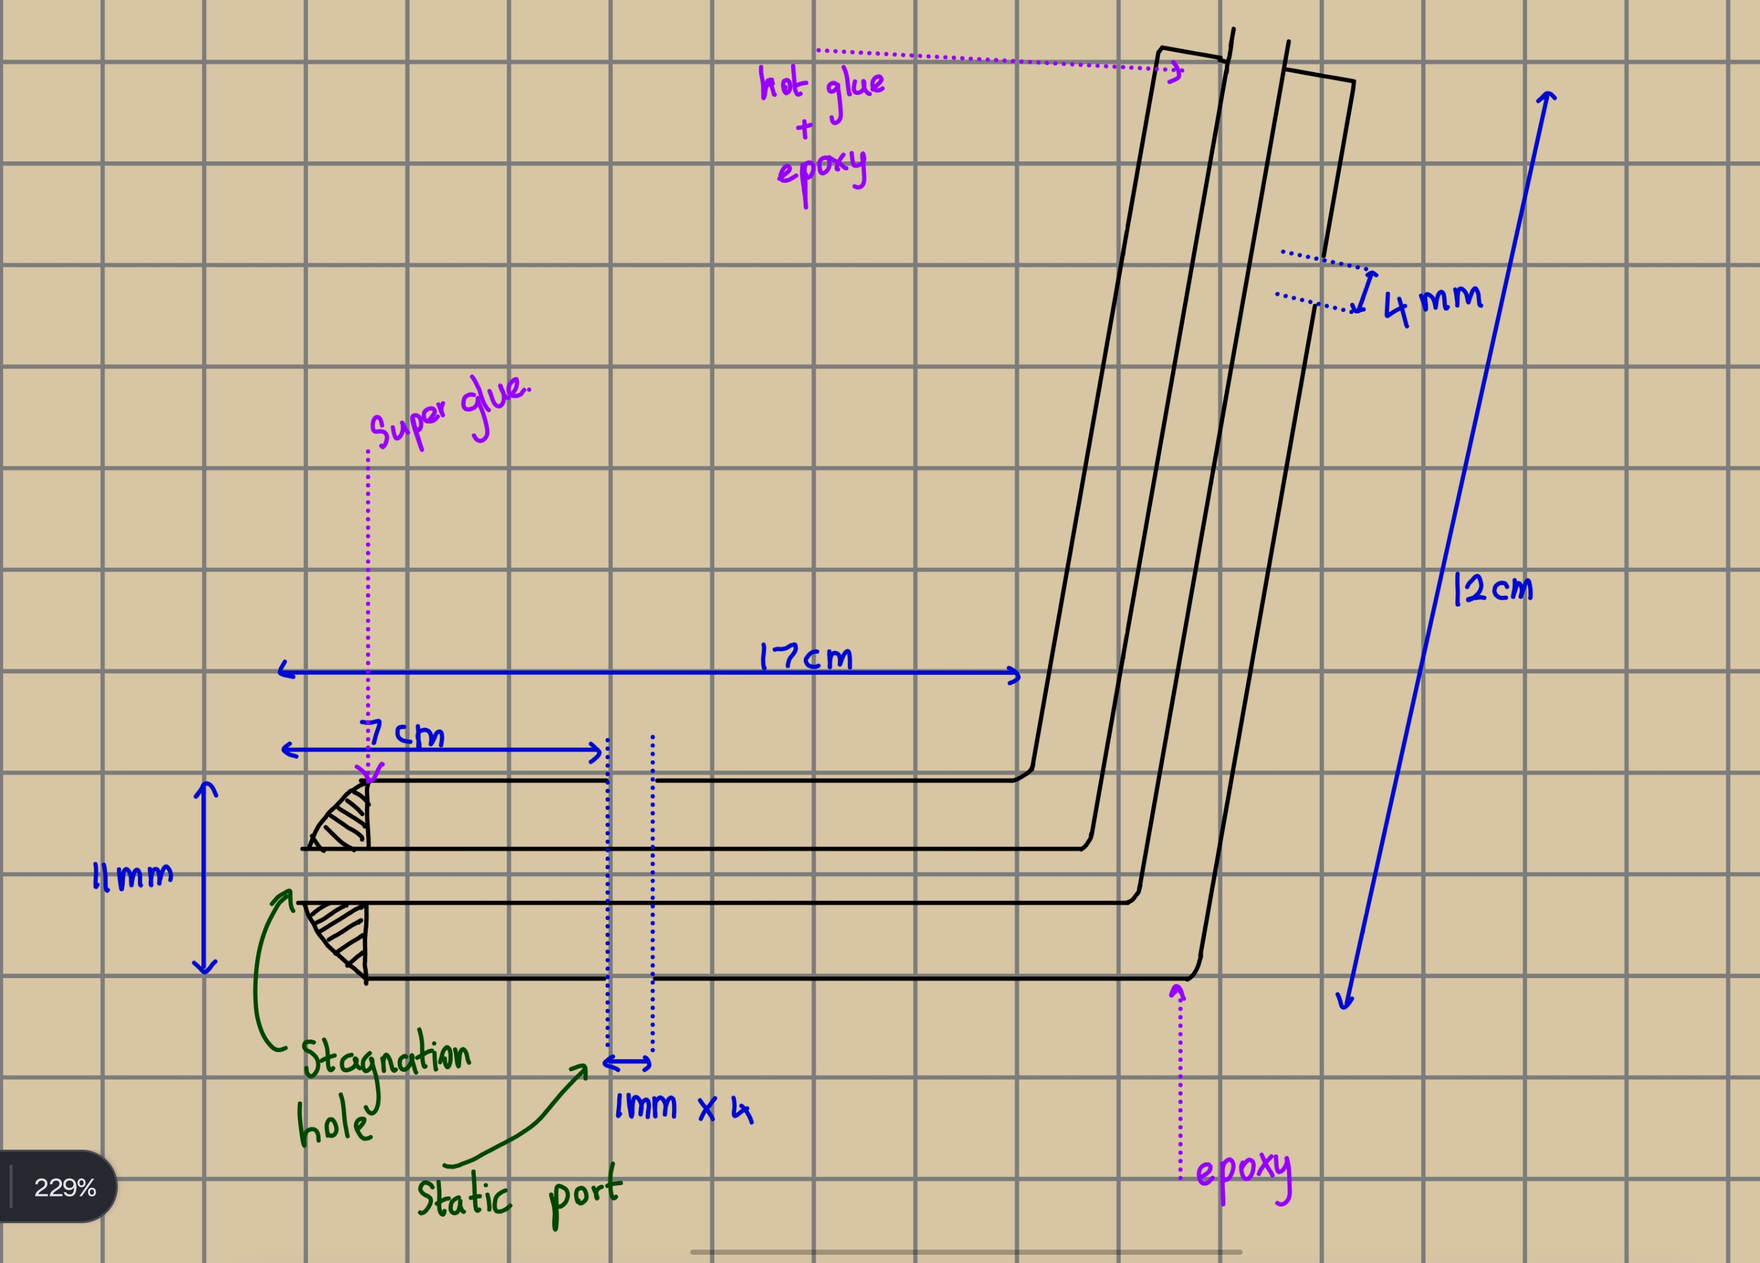
Conceptual Design & Specifications
Initial Sketch
Prior to fabrication, the assembly was mapped out to ensure the geometry minimized turbulent wake over the measurement ports.
•
Forward Boom: 170mm length required to project past the scooter's frontal bow wave.
•
Outer Casing: 11mm PVC acts as the static pressure averaging chamber.
•
Inner Tube: 4mm rubber line routed directly from the tip to the sensor.
•
Mounting Angle: Designed with a 108° elbow to perfectly offset the scooter's steering stem rake.
03

Slide 5
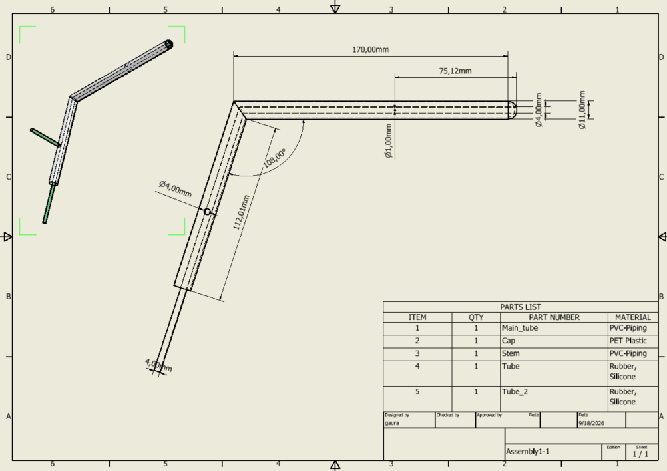
Final Design & Specifications
Technical drawing done using
Autodesk Inventor
04

Slide 6
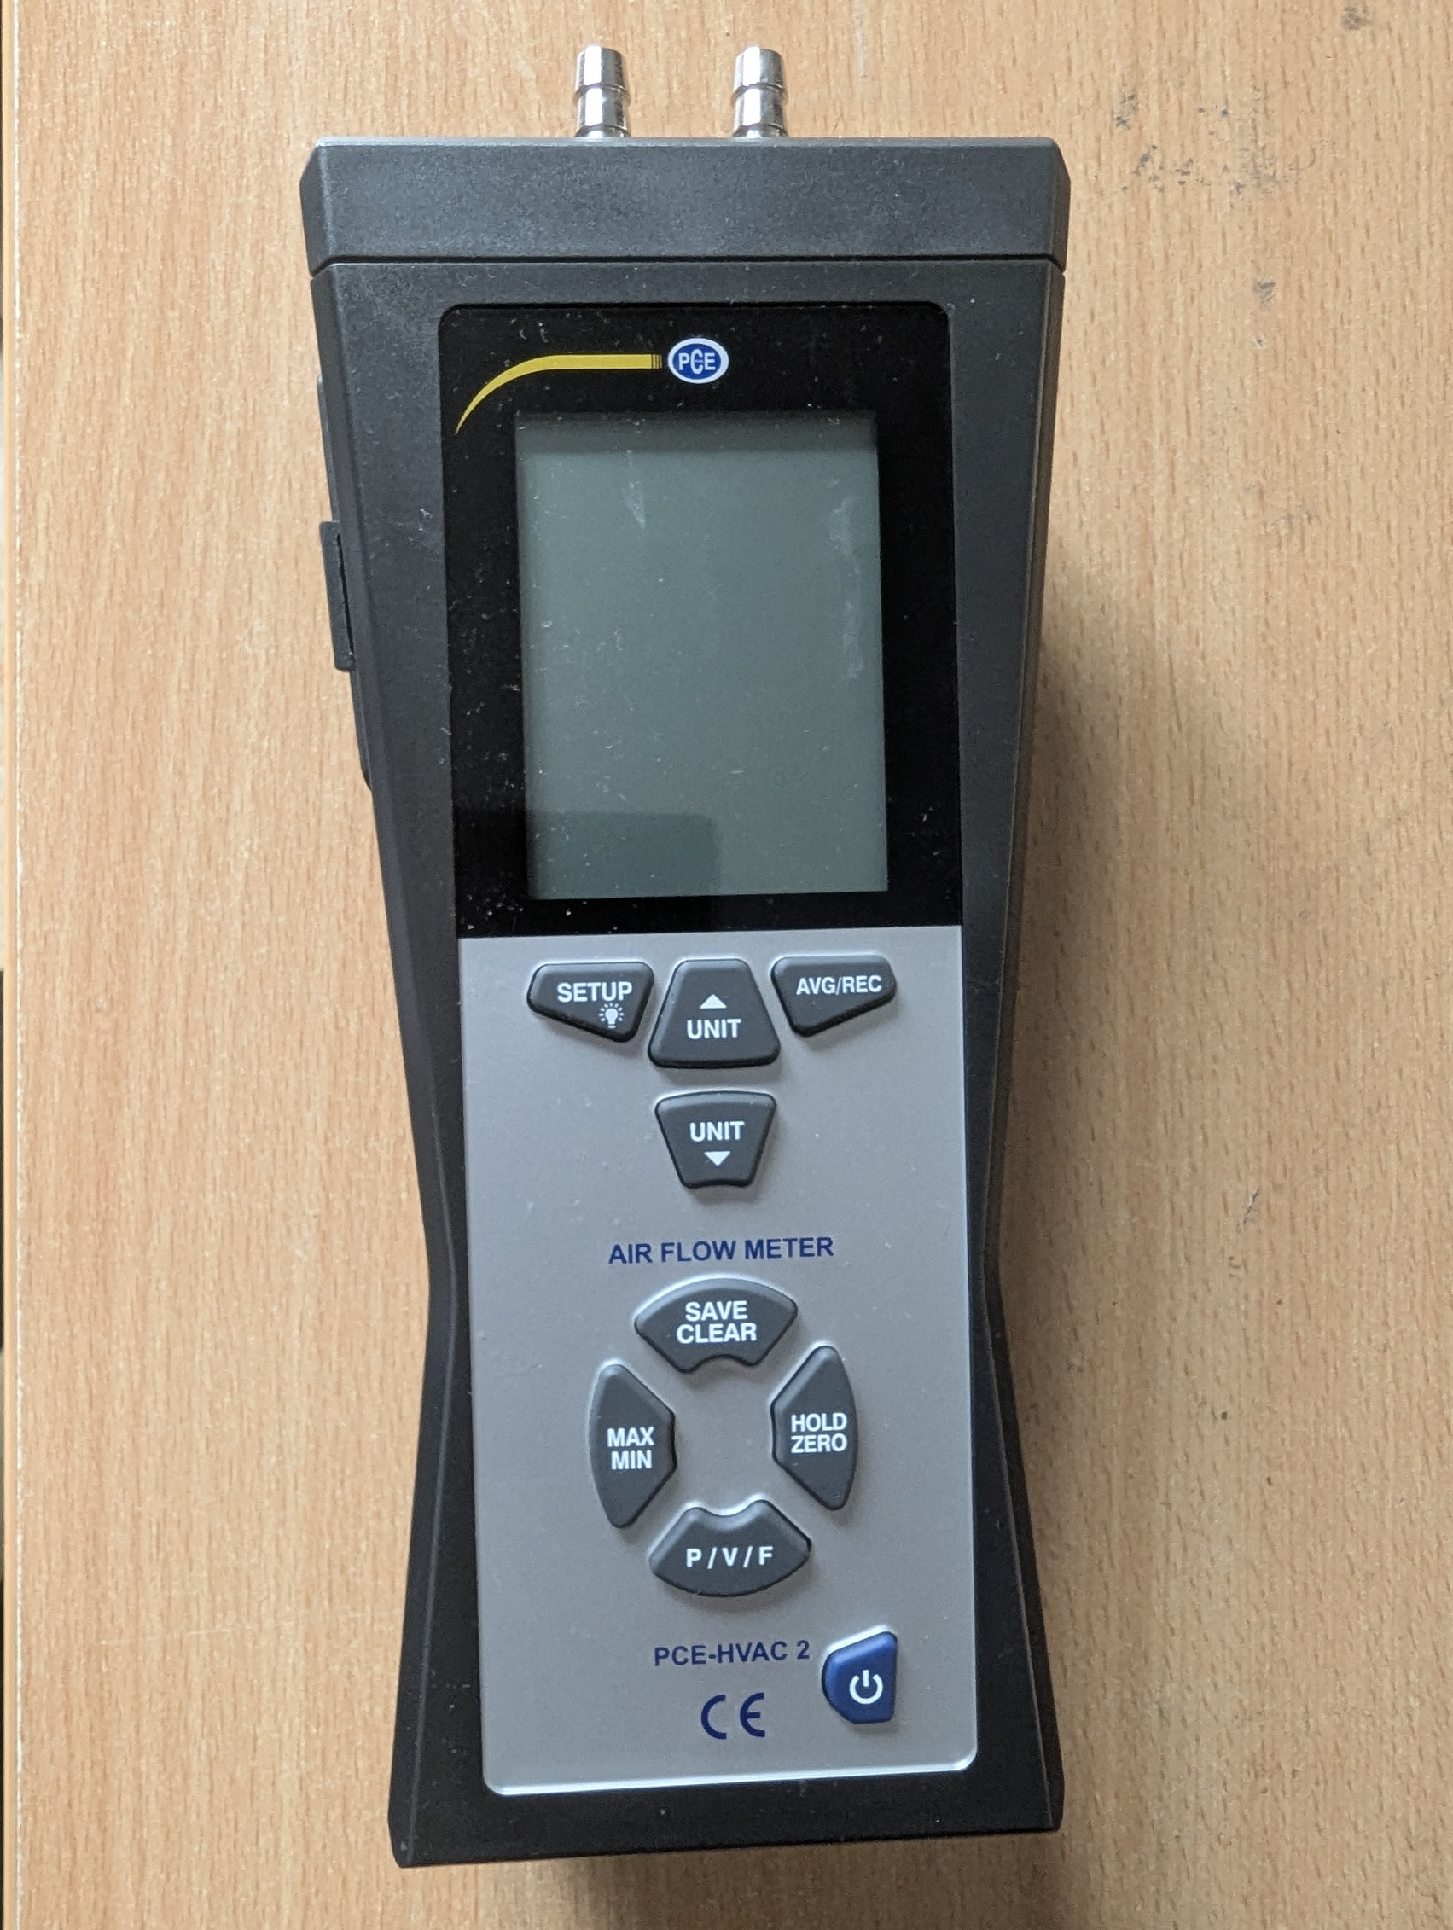
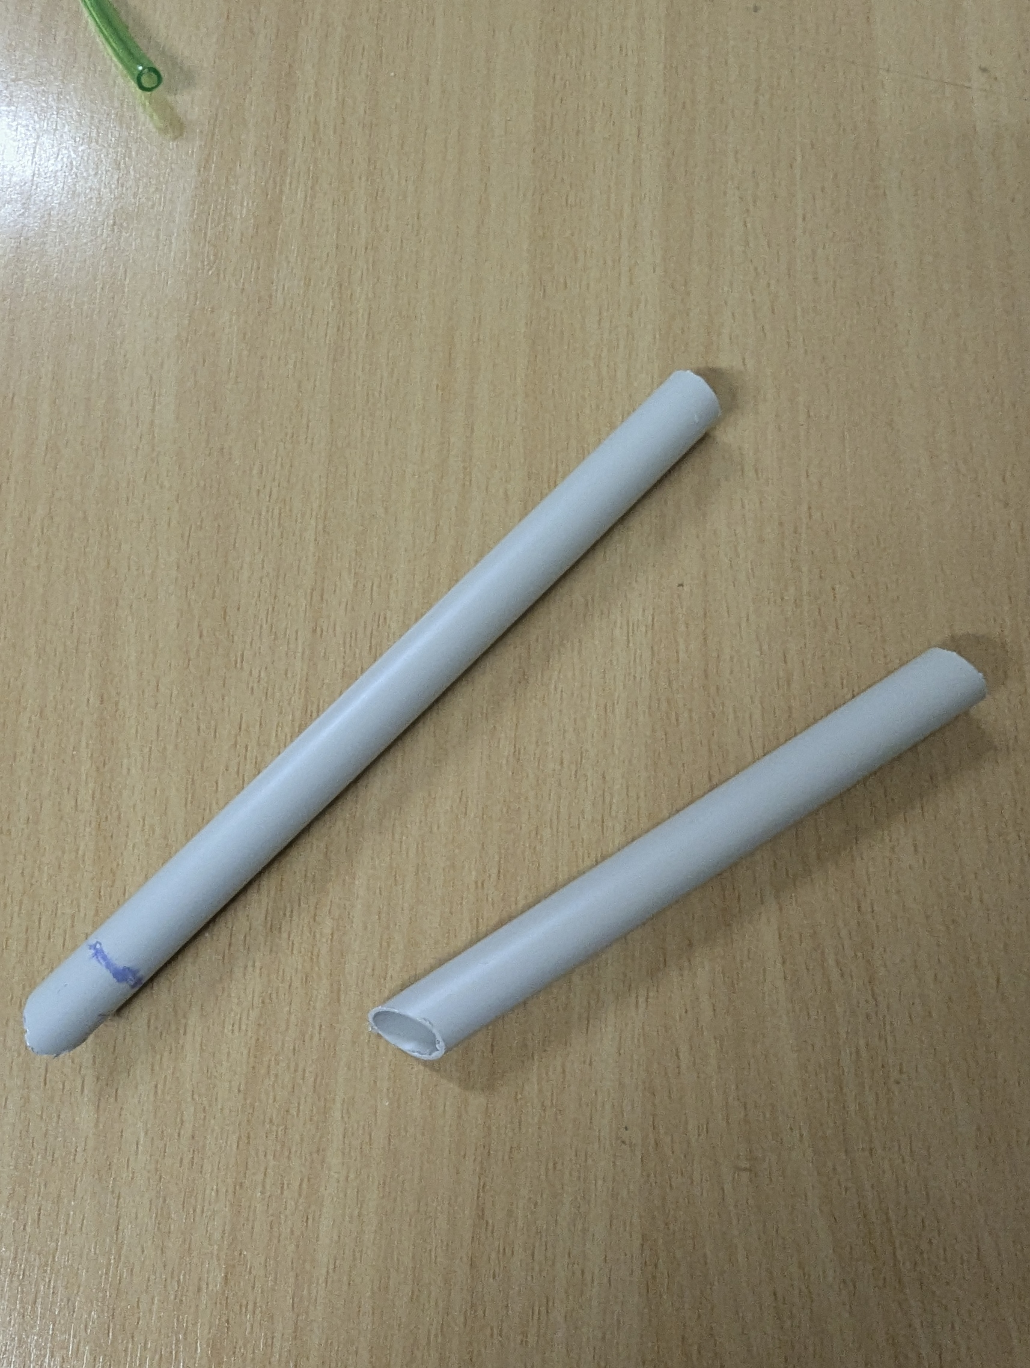
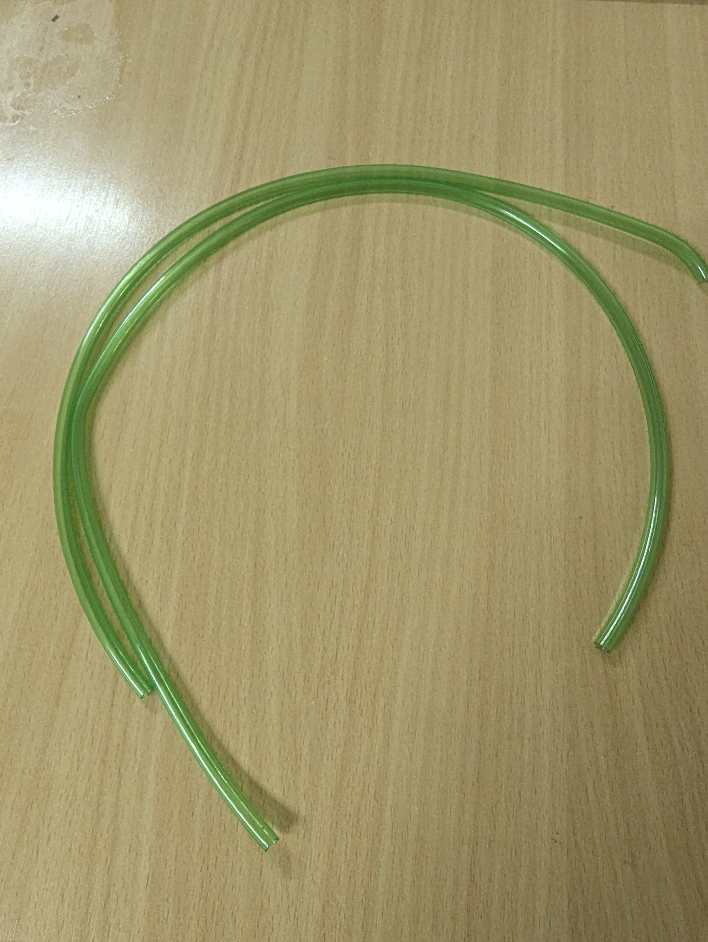
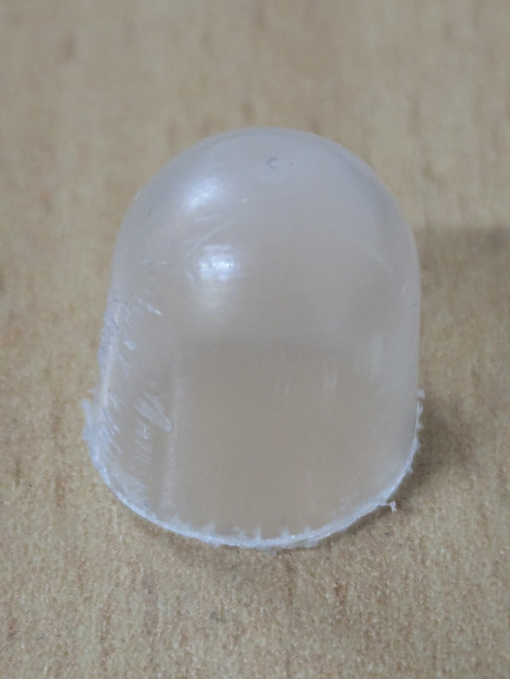

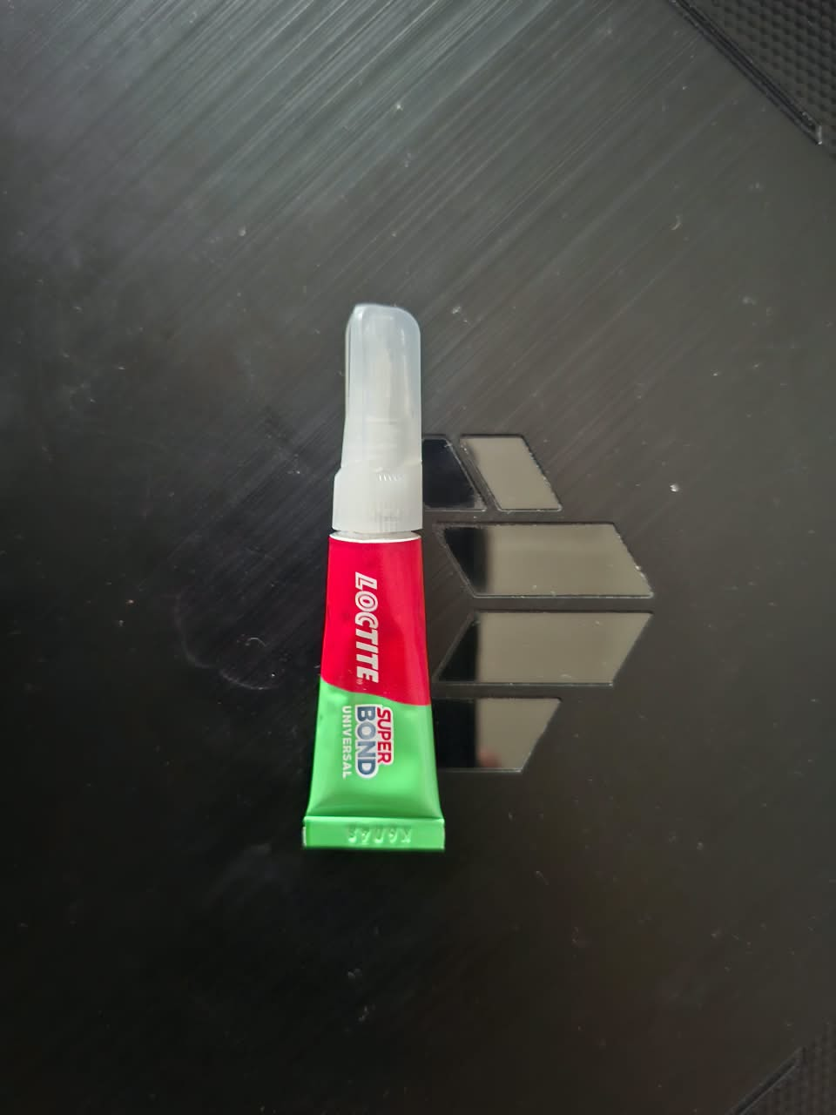
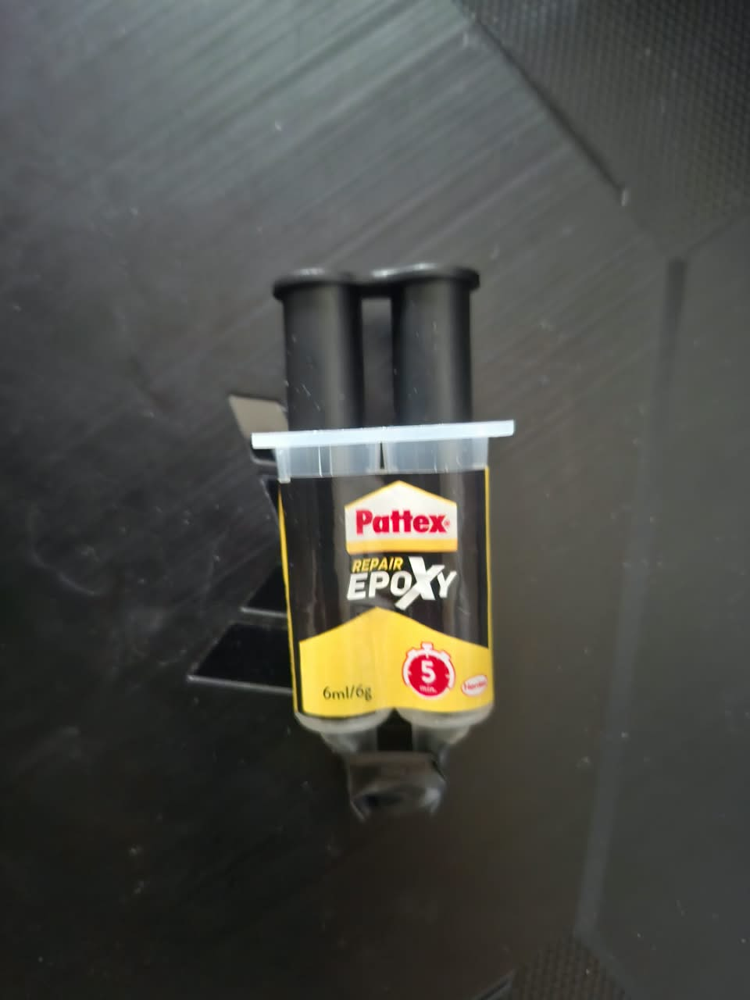
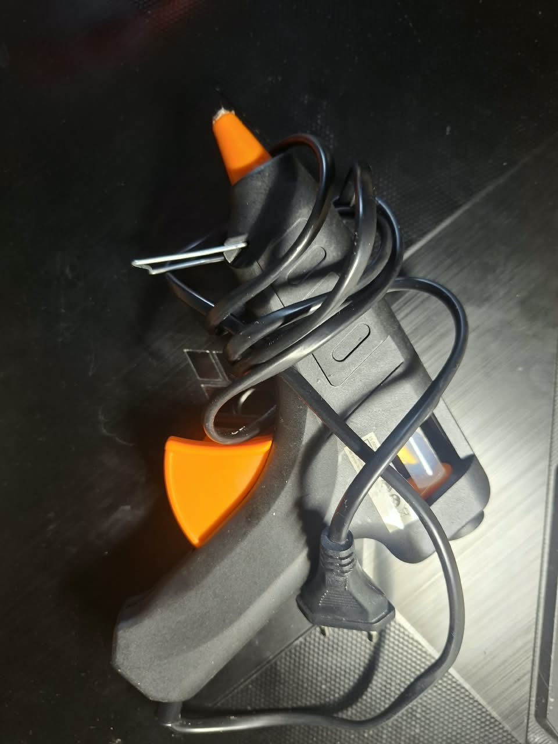
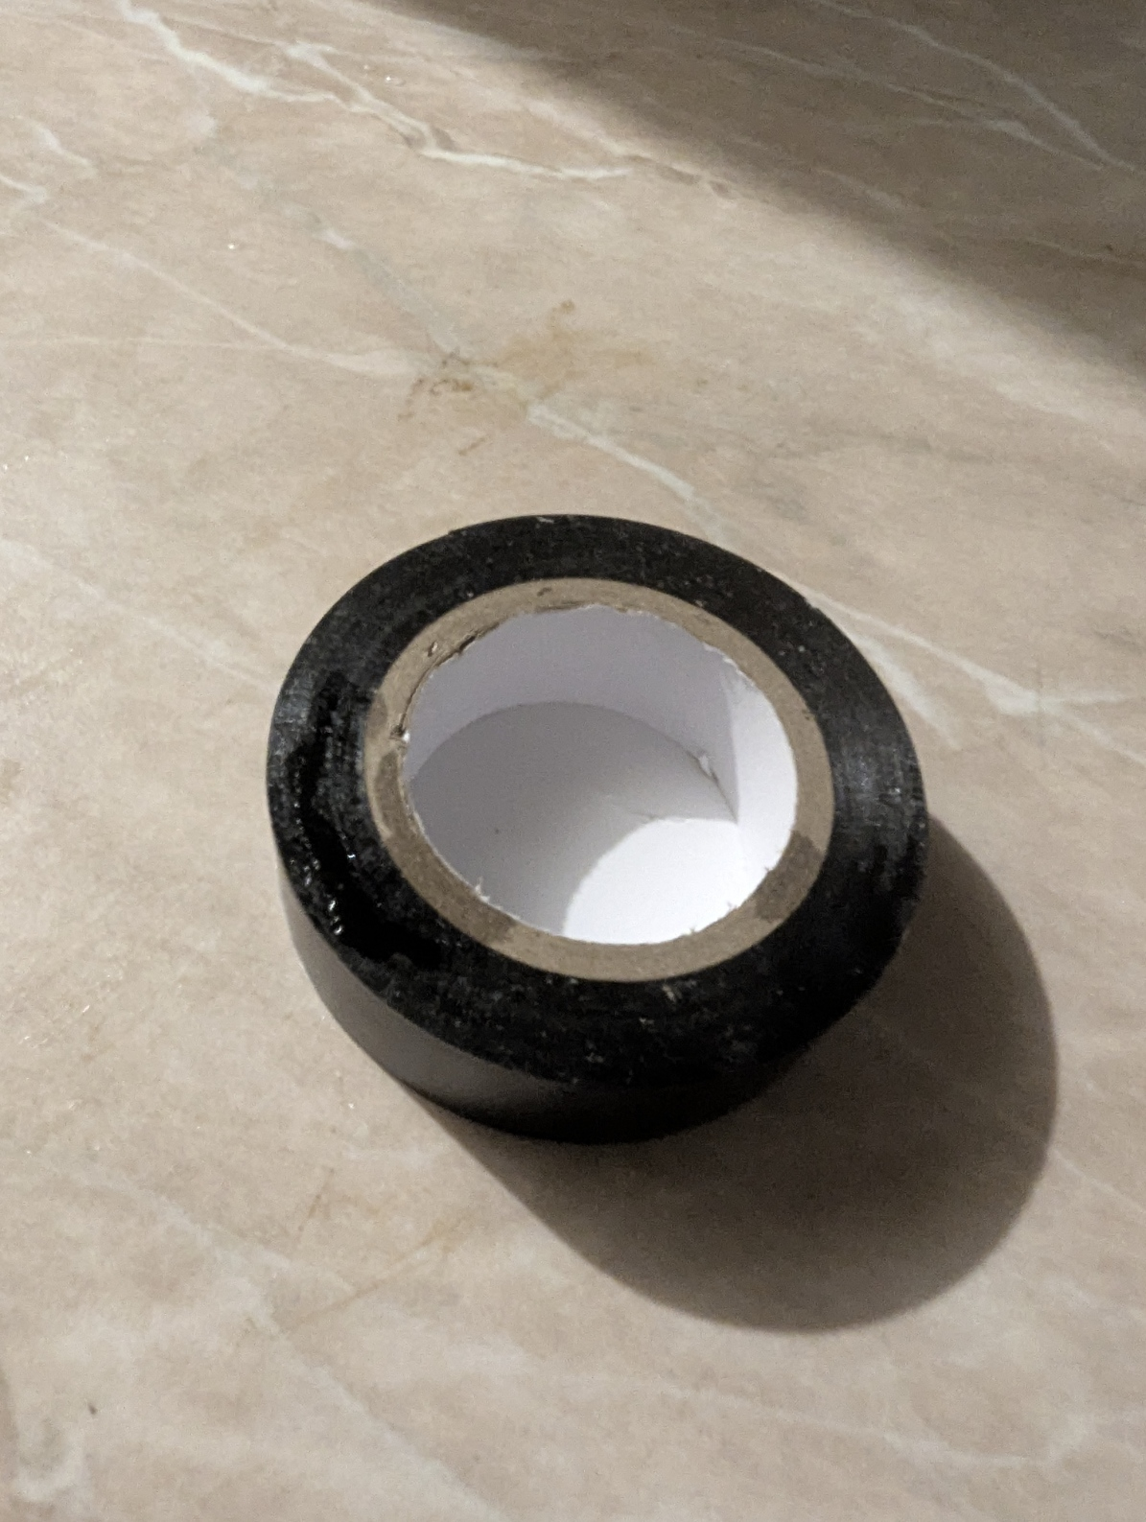
Equipment & Materials
PCE-HVAC 2
Digital manometer
Electric conduit tube
Silicon-rubber tube
Repurposed sauce bottle cap
Super glue
Epoxy
Glue gun and hot glue
Insulation tape
05

Slide 7


Fabrication: Nose Cone & Joints
1. Modifying the Cap
2. The 108° Custom Elbow
The transparent sauce bottle cap featured sharp longitudinal edges.
These were sanded completely smooth to prevent tripping the boundary layer.
The cap was bonded flush to the 11mm PVC pipe using super glue, ensuring the 3mm stagnation tube protruded perfectly straight through the center.
Standard 90-degree PVC fittings would point the Pitot tube downward due to the scooter's raked stem.
We cut the pipes and bonded them using structural epoxy at exactly 100 degrees.
This ensures the forward boom remains perfectly horizontal and parallel to the incoming airflow during operation.
06

Slide 8
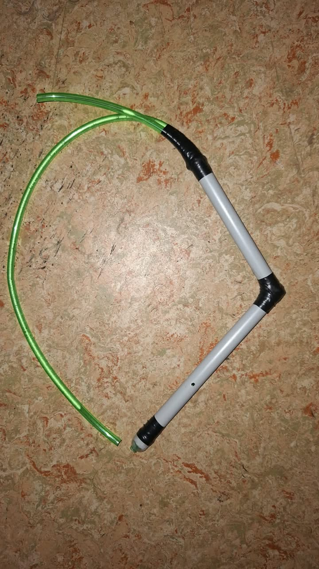
Assembly & Sealing
Creating the Static Chamber
For the system to work, the outer 11mm PVC pipe must act as a completely airtight pressure vessel. Any leaks would immediately equalize the pressure, destroying our data.
Two-part epoxy was pumped into the bottom exit gap, sealing the space around the 3mm inner tube. Once cured, all bonded joints were heavily wrapped in wiring tape to provide a secondary air seal and critical structural reinforcement against road vibrations.
Attachments reinforced through
Electrical insulation tapes
07

Slide 9
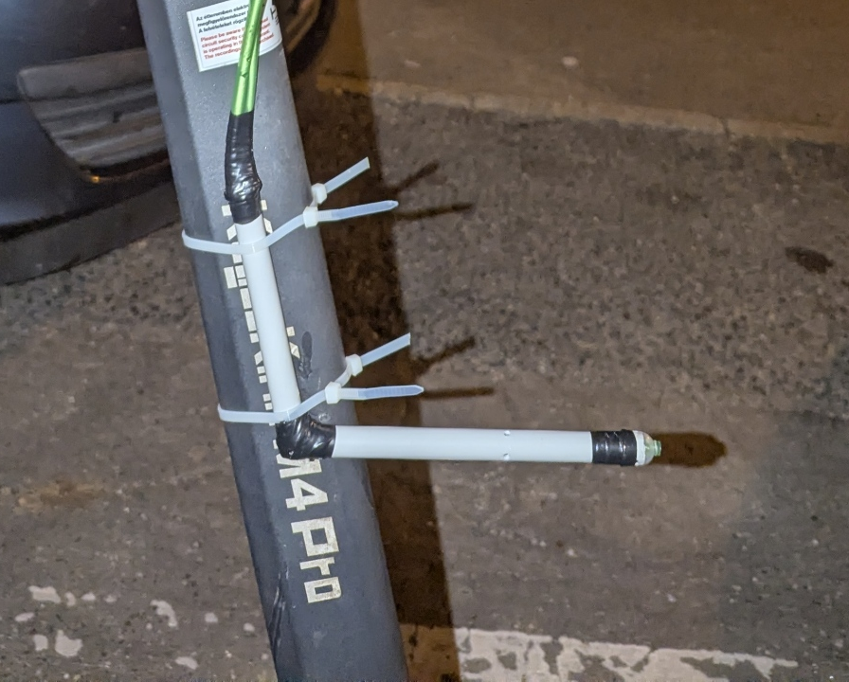
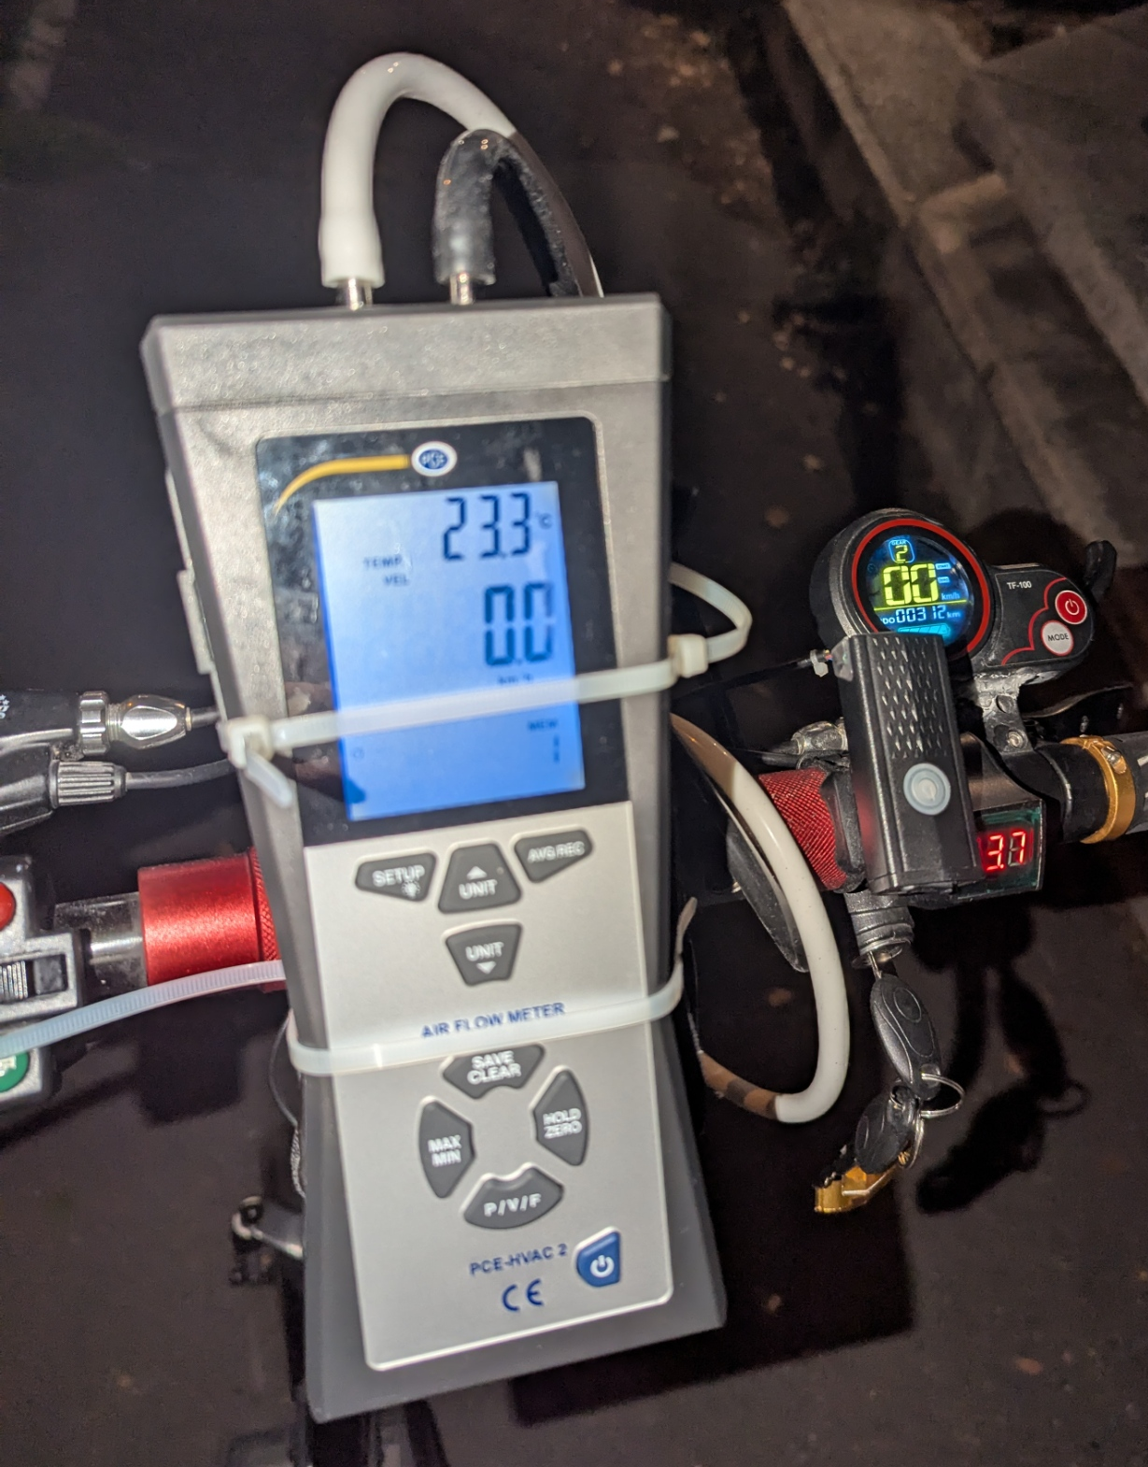
The Mount
Zip-Tie Implementation
For the initial proof-of-concept road tests, the Pitot-static assembly was mounted directly to the electric scooter's angled steering stem.
•
zip-ties were used to secure the vertical PVC stem.
•
This allowed for immediate field testing, easy height adjustment, and angle verification.
•
The digital manometer was secured near the handlebars for real-time memory logging.
•
The Trade-off: This non-rigid mounting solution introduced structural flex under high aerodynamic loads.
08

Slide 10
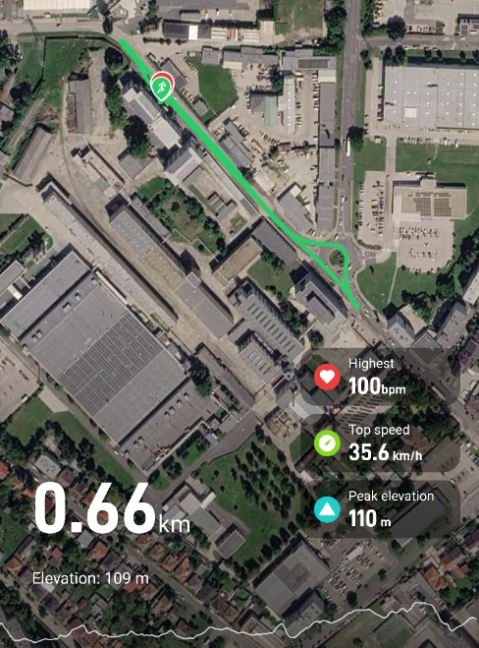

Data Collection
Testing was conducted on a flat, straight road. Speed was incrementally increased and held steady while logging values from the GPS Watch (Ground Speed) and the Manometer (Airspeed).
Test Phase | 01 | 02 | 03 | 04 | 05 | 06 | 07
Scooter Dash (Target) | 0 | 10 | 15 | 20 | 25 | 30 | 35
GPS Watch (km/h) | 0 | 11.89 | 16.00 | 21.10 | 25.79 | 32.29 | 35.59
Manometer (km/h) | 0 | 7.00 | 13.90 | 18.80 | 23.00 | 28.20 | 31.40
Track used for measurements
09

Slide 11
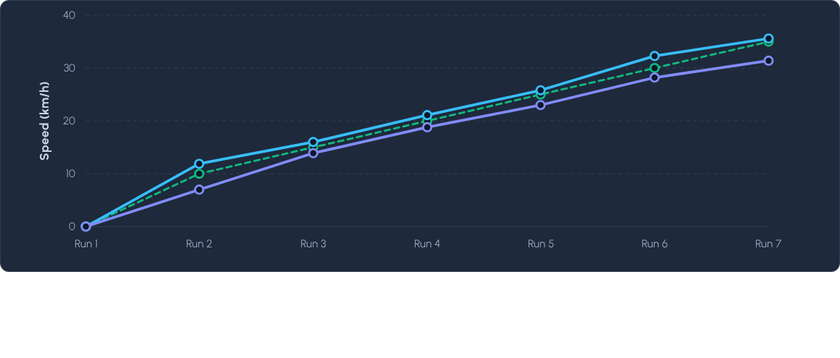
Ground Speed vs. Measured Airspeed
10

Slide 12






Analysis: Identifying Deviations
The "Bump" Effect
Misaligned Taps
High-Speed Flex
A slight lip where the sauce cap met the PVC created a minor speed bump for the air. This tripped the boundary layer, causing localized turbulence over the static holes and artificially lowering static pressure readings.
Hand-drilling the 1mm static ports resulted in slight asymmetrical spacing. During steering wobbles or minor crosswinds, the static chamber could not perfectly average the pressure gradient around the circumference.
At speeds exceeding 25 km/h, aerodynamic drag caused the zip-tie mount to flex backward. Tilting the nose cone off the direct stagnation axis immediately skewed the high-speed data.
11

Slide 13
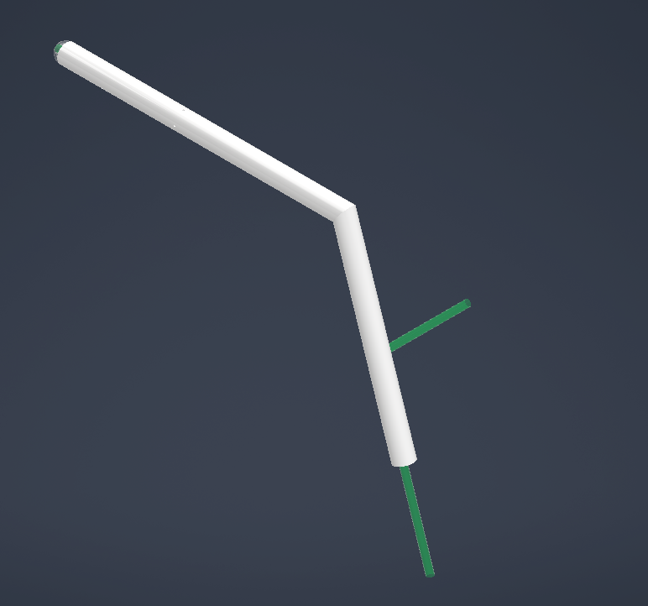
Model vs. Final Build
Theoretical CAD Model
Physical Execution
The digital model represents perfect geometric symmetry, flush aerodynamic surfaces, and rigid 90-degree transitions without airflow disruption.
The physical prototype highlights the realities of dorm-room fabrication: epoxy overflow, tape wrapping for vibration damping, and a repurposed nose cone.
12

Slide 14
Conclusion & Future Scope
The DIY PVC Pitot-static tube successfully proved the concept, demonstrating a highly accurate measurement window near 20 km/h. To eliminate the aerodynamic deviations observed at high speeds, V2.0 will feature a fully 3D-printed uni-body design for perfect static port symmetry, coupled with a rigid, bolted aluminum clamp to completely eliminate mounting deflection.
13

Slide 15
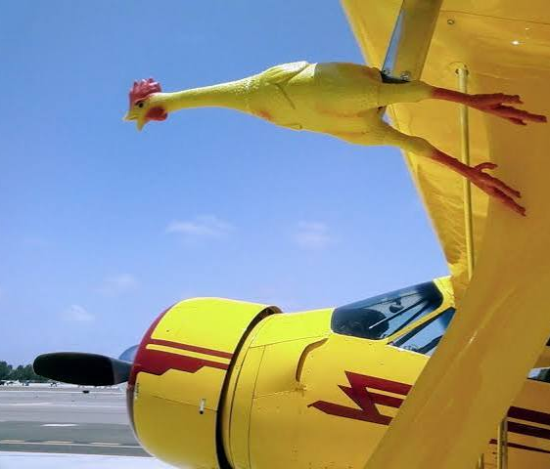
Thank you for your time.

